Slide 1
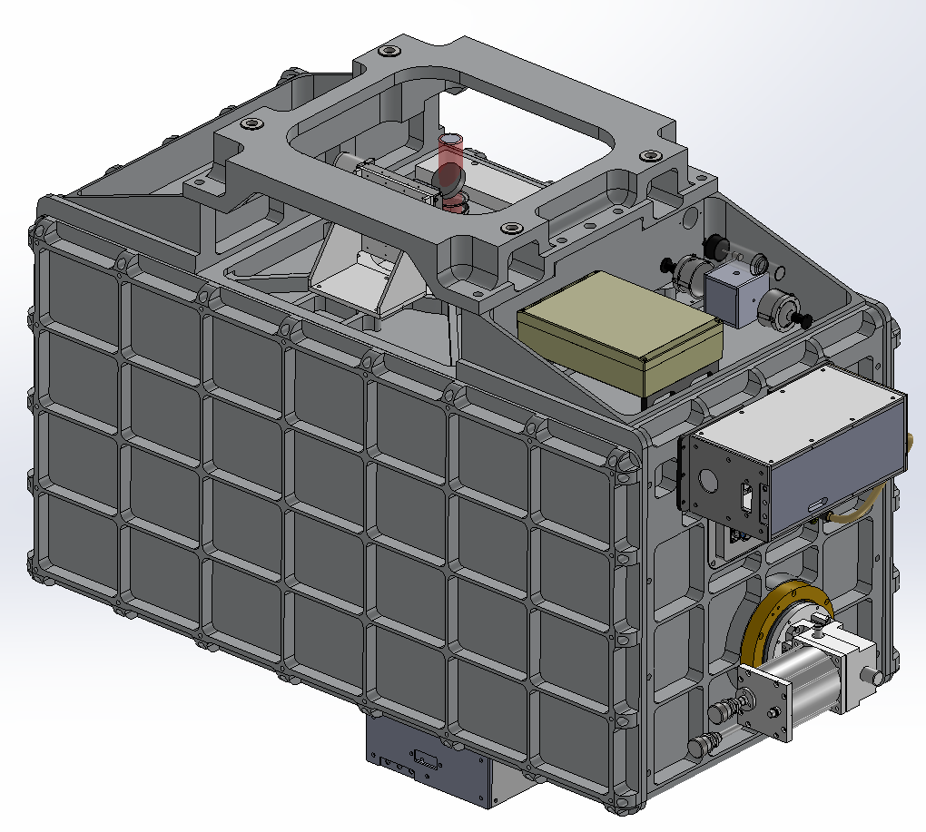
iSHELL Design Review Cryostat & Optics Bench
Dan Kokubun
11/8/2013

Slide 2
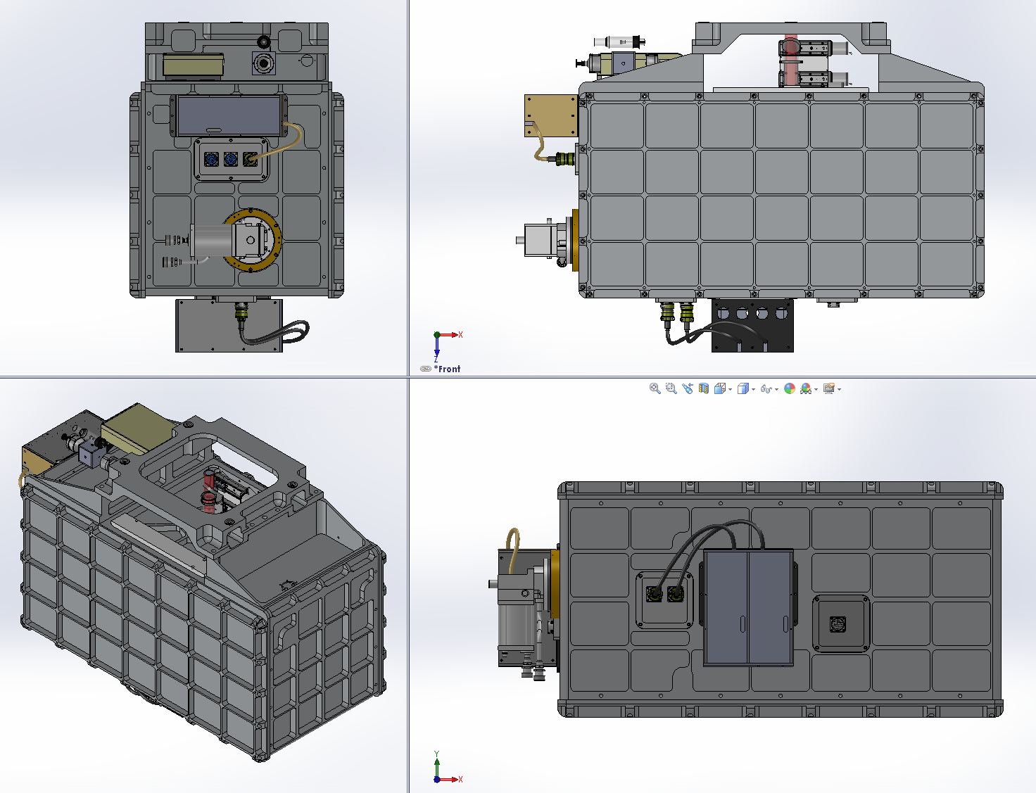
Overview
3/8” tapped holes on covers, bottom, and sides.
Can be used for:
handles
Jigs
protective frame
feet.

Slide 3
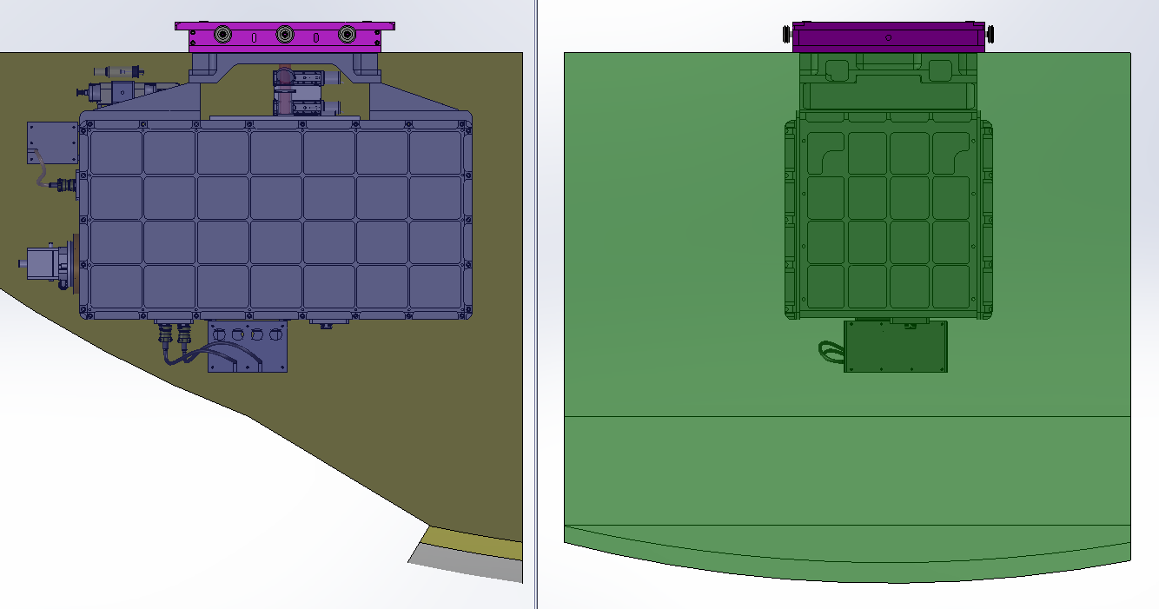
Overview – Telescope Clear Envelope
Telescope clear envelope shown around instrument.
Estimated Weight: 1040 lbs
CG: within 2” of optical axis
Clear Envelope

Slide 4
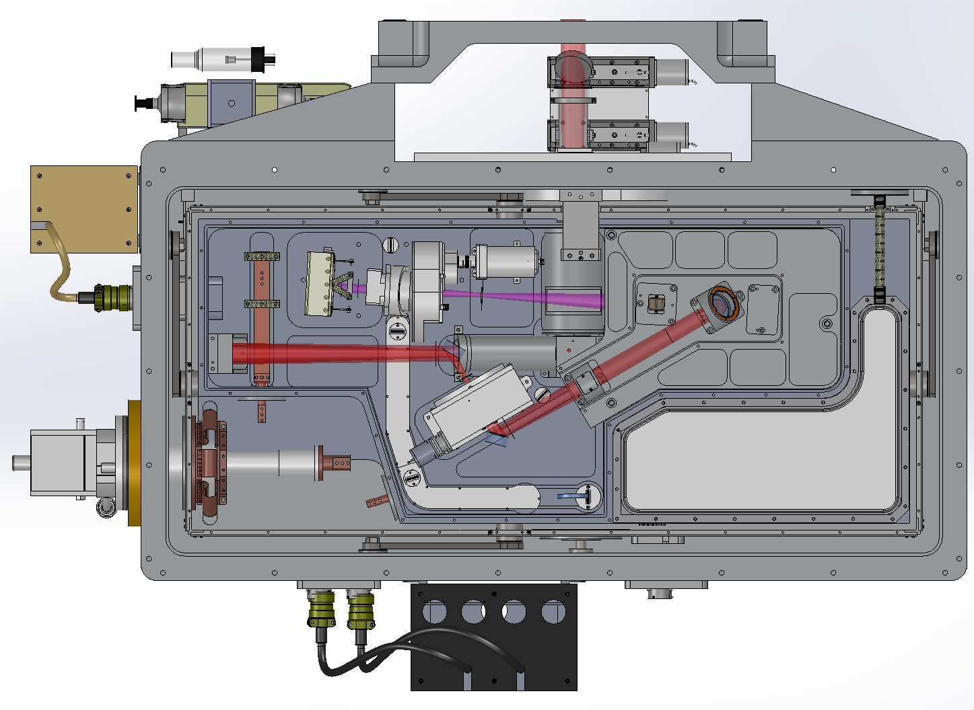
Overview
Cal Box dust cover not shown
Aladdin
Cal Box
Aladdin
Controller
LN Can
Rotator Mechanism

Slide 5
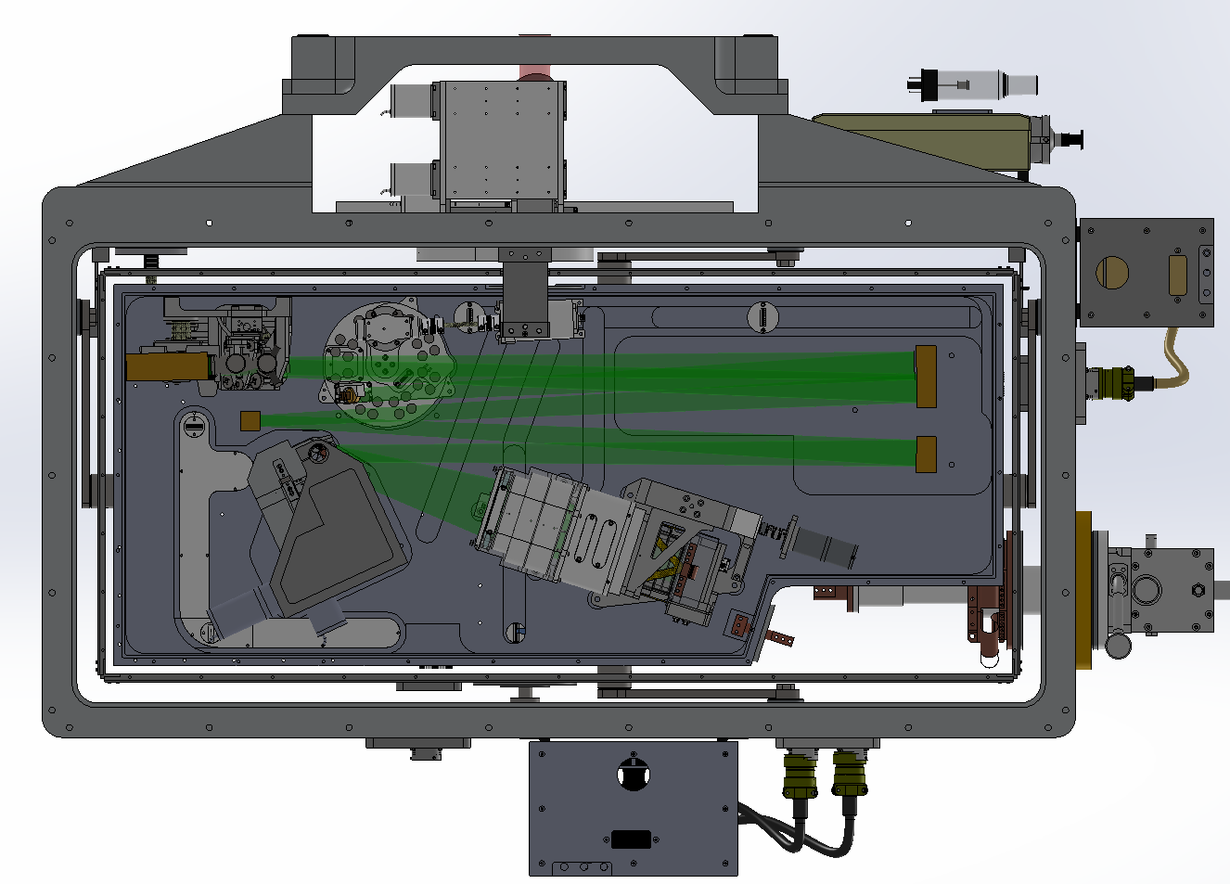
Overview
Order Sorting
Mechanism
Cal Box dust cover not shown
IG Changer
*upgrade
Cal Box
X Disperser
Mechanism
H2RG
Controller
H2RG

Slide 6
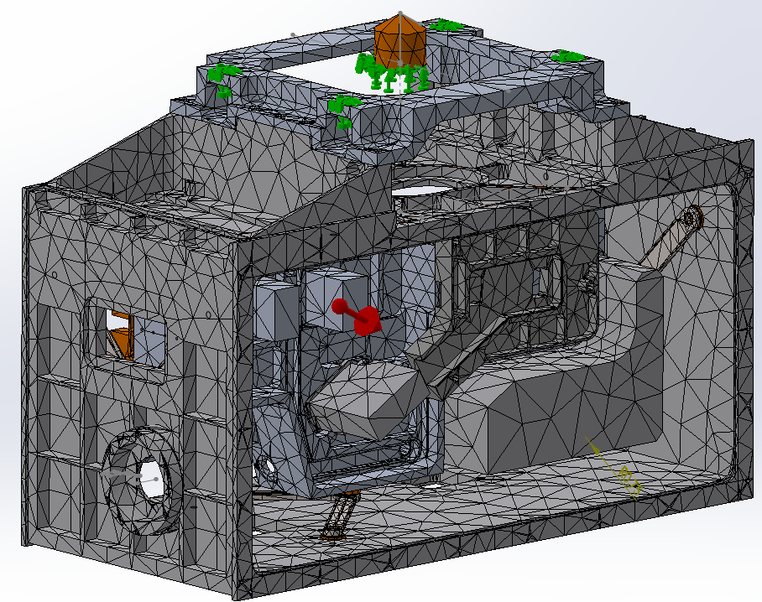
FEA - Flexure Study
Requirement: Co-alignment of the cold stop and telescope exit pupil to within 1% of their diameters...
This is equivalent to 2.4mm image displacement at the secondary
Worst case gravity vectors used (60° from zenith)
The resulting angular deflection of the optical axis is expressed as image displacement at the secondary
Maximum contribution is 0.61 mm ; 25% of the allowable displacement
N
E
S
W
N
Includes Contributions From:
Telescope Mount
Cryostat
Trusses
Optical Bench

Slide 7
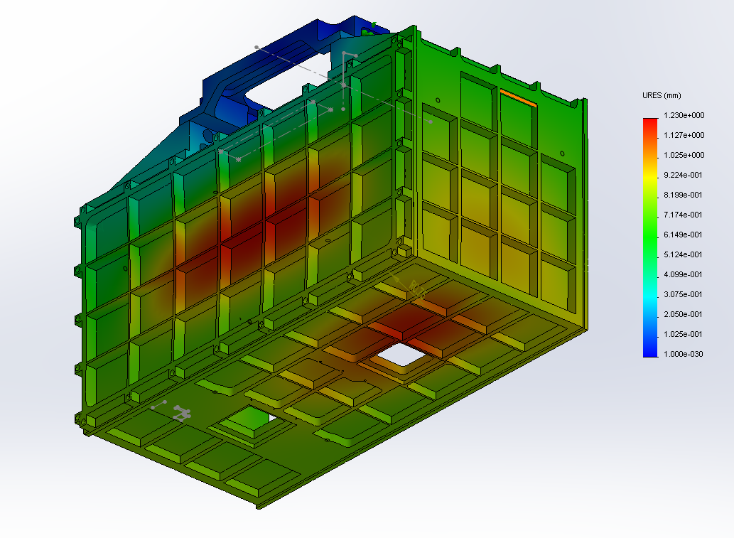
FEA - Stiffness Under Vacuum
Maximum deflection at center of cover is 1.2mm

Slide 8
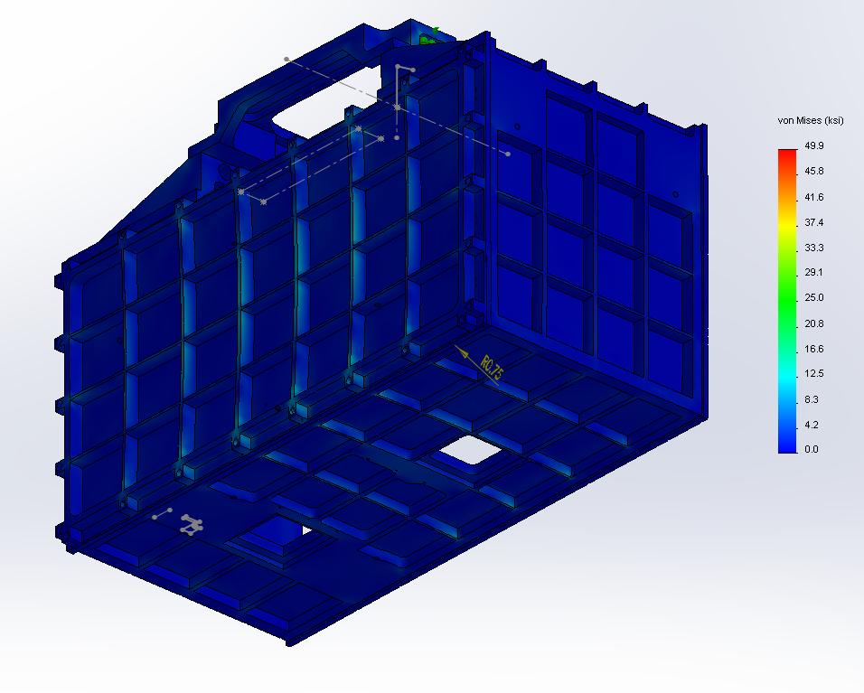
FEA - Stiffness Under Vacuum
Maximum stress at ribs on cover is < 15 kpsi; safety margin of 2.7 for 6061-T6
Stress points on bottom around 11 kpsi; safety margin of 2 for 50XX-T0

Slide 9
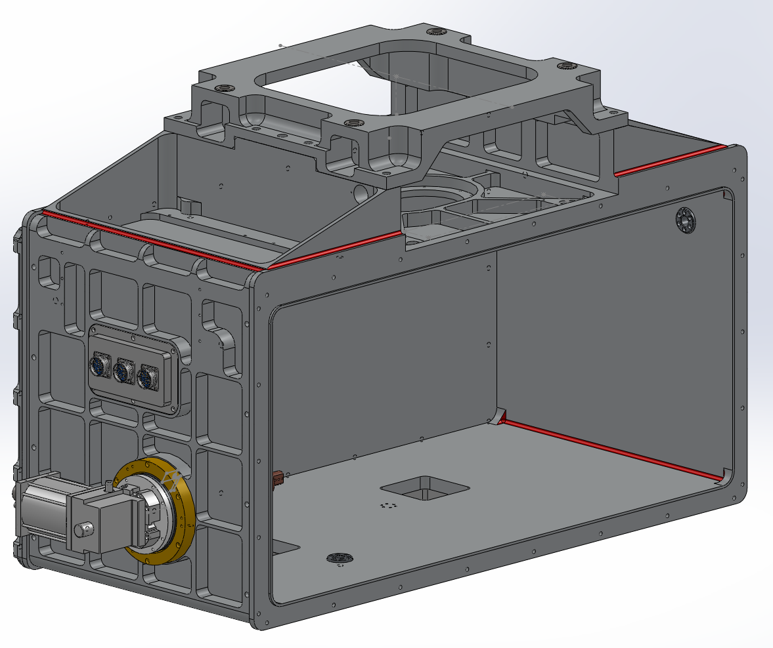
Cryostat - Housing
Welded Structure (welds shown in red)
Cryostat design has been developed in cooperation with the cryostat vendor.
Parts milled from billet
Inserts for Truss mounts screwed in place
Will use 5083-T0 or 5056-T0 to avoid heat treating
Elastic Modulus for all alloys are about the same so deflections will be identical
Inside surfaces are polished
Outside surfaces are painted
 | Tensile Yield | Notes
AL 5083-T0 | 21 kpsi | No heat treat
AL 5056-T0 | 22 kpsi | No heat treat
AL 6061-T6 | 40 kpsi | Heat treat required post welding. Severe warping expected

Slide 10
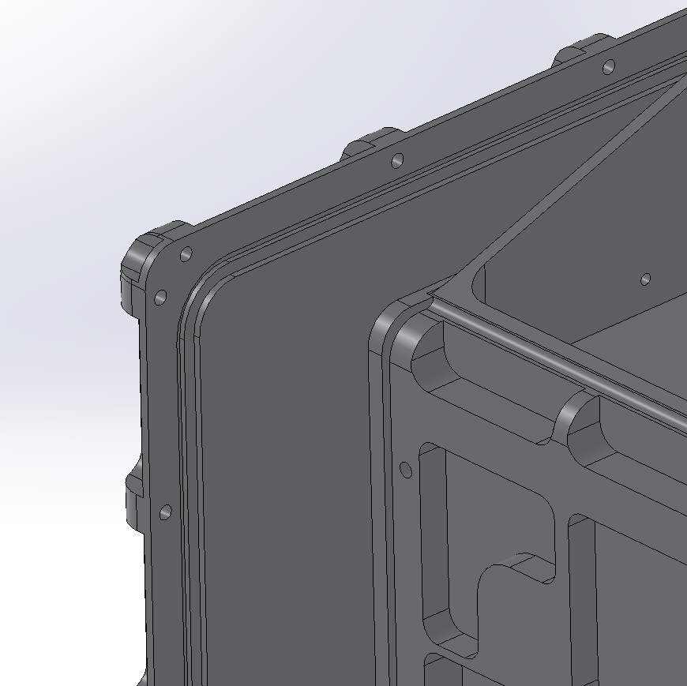
Cryostat Cover
Step on cover supports walls under vacuum
Dovetail O-ring groove to retain o-ring.
O-ring groove in cover
3/16” dia o-rings

Slide 11
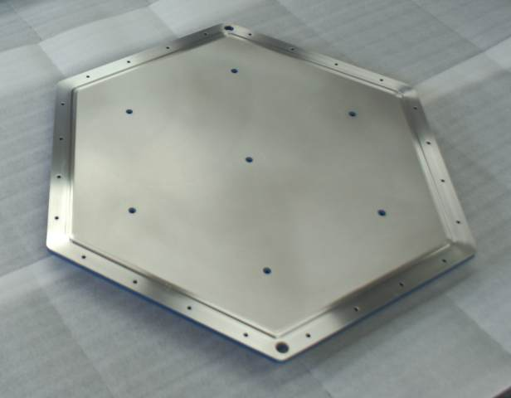
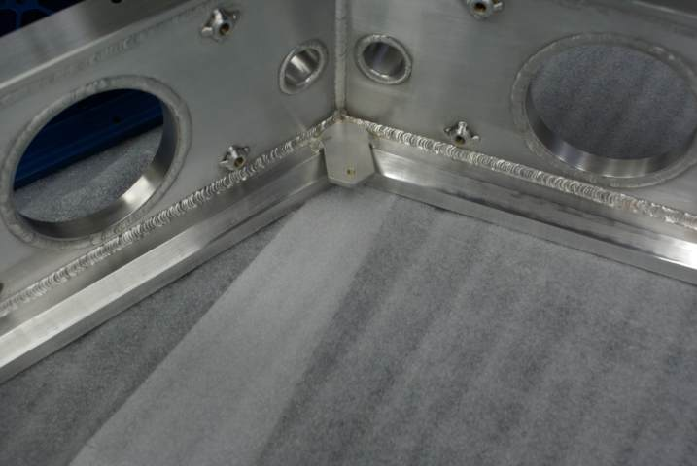
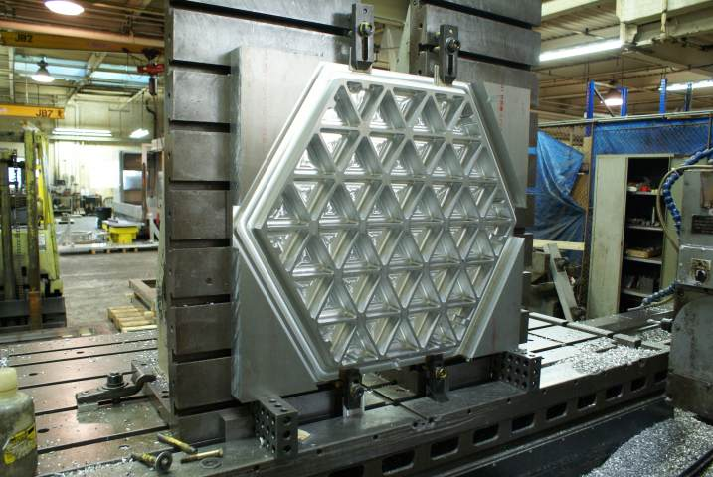
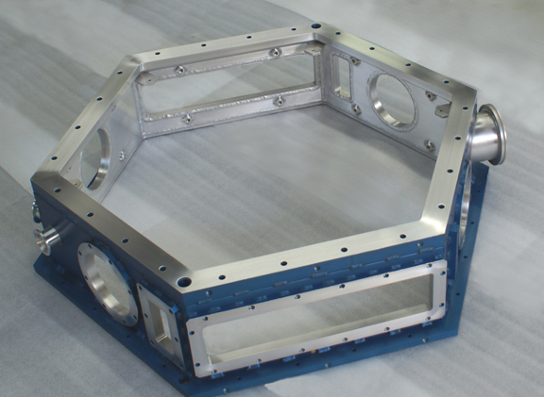
Cryostat Vendor – Meyer Tool & Manufacturing
AURA One Degree Instrument (ODI)
Vacuum rated welds
O-ring grooves with dovetail
Large Capacity Milling Machines
Vacuum testing capability

Slide 12
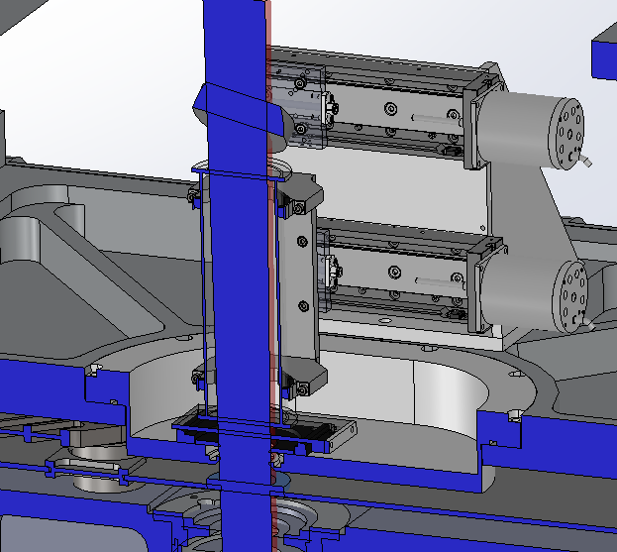
Cryostat - Window
Window mount is inset to allow space for a gas tube used for calibration
A motorized door covers the window when it is not in use
Debris cup to be installed on the back of the fold mirror
Window bezel reduces the amount of debris falling onto window.

Slide 13
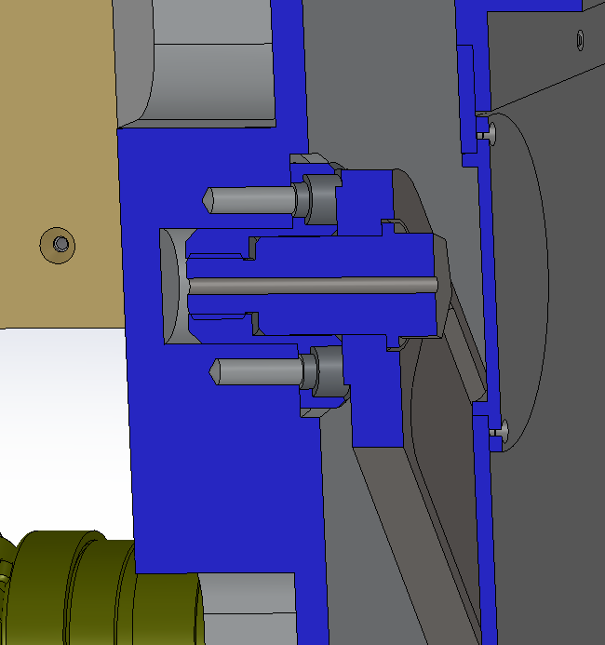
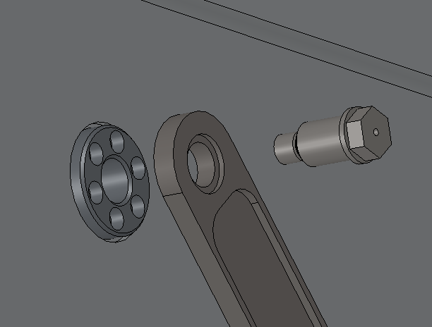
Cryostat – Warm Side Truss Mounts
Truss
Warm Side Mount
Custom shoulder screw
Use loose fitting threads for better fitment
Stainless insert in cryostat wall
Radiation
Shield
Cryostat
Custom Shoulder Screw
Stainless Insert
Truss

Slide 14
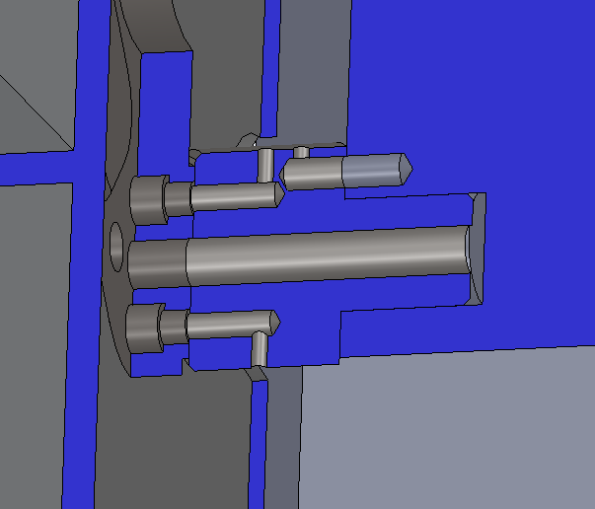
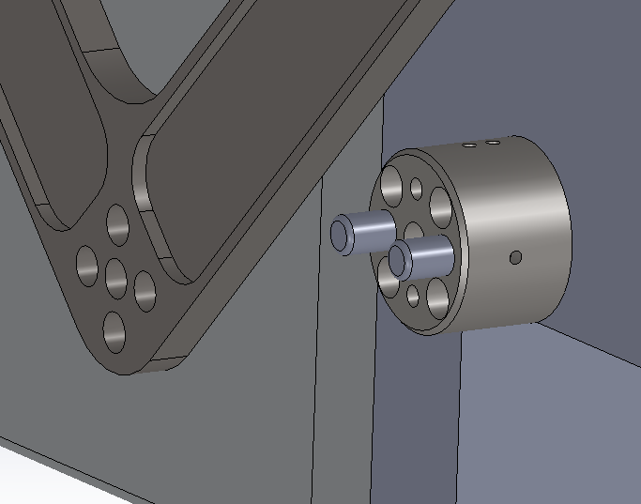
Cryostat – Cold Side Truss Mounts
Cold Side
Two 3/8” pins, two ¼-20 screws
Stainless insert in bench with clocking pin
Cold Bench
Stainless Insert
Cryostat
Truss
Radiation Shield
Truss
Stainless Insert
3/8” pins
¼-20 tapped holes

Slide 15
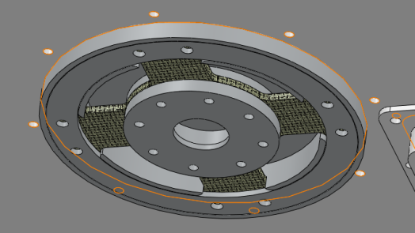
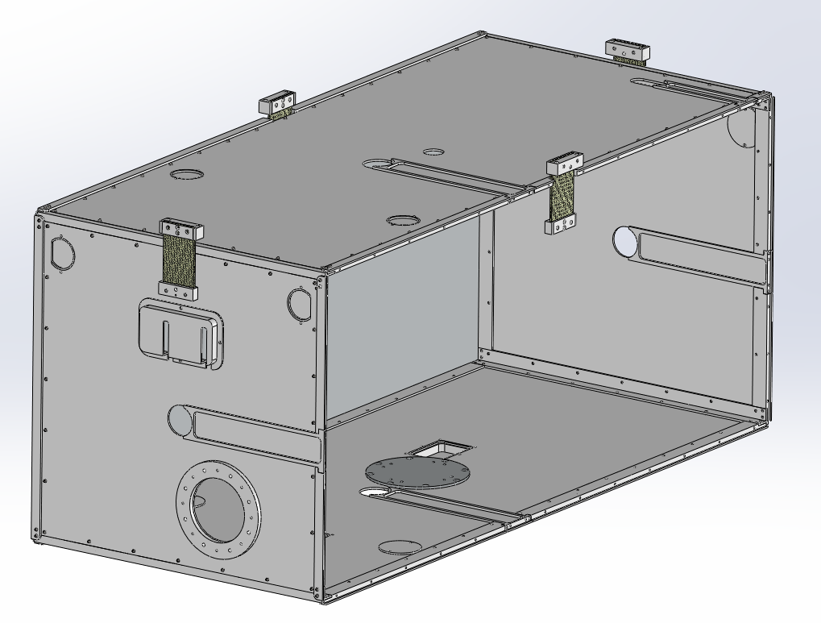
Cryostat – Radiation Shield
G-10 Spokes (4x)
Support Pin
Bearing Surface
G-10 Mount Tabs (4x)
1.9W Heat Load – similar to Spex
Truss Mount Bolt
Access Covers (8x)
Lower Support Assembly
Support pin mounted to the cryostat will provide mechanical support to the bottom of the radiation shield
Small thermal cross section at bearing surface
Wire Harness
Access Panels (3x)
Lower Support Assembly
Truss Clearance Slots
With Covers (4x)

Slide 16
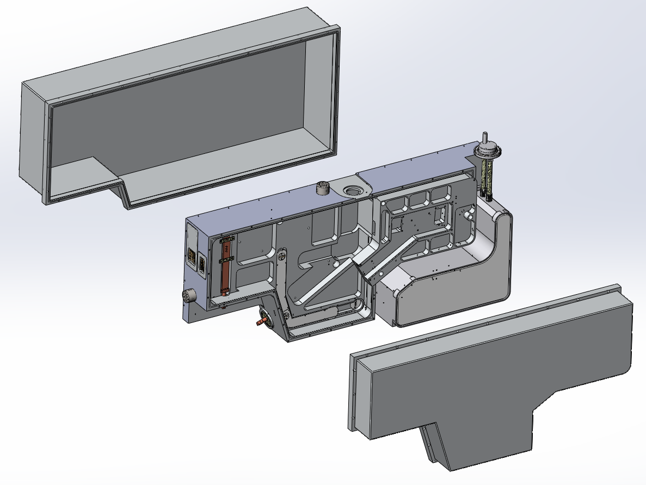
Optics Bench
Photon Shield
Spectrometer
LN Can
Bench
Bus Bar
Photon Shield
Foreoptics

Slide 17
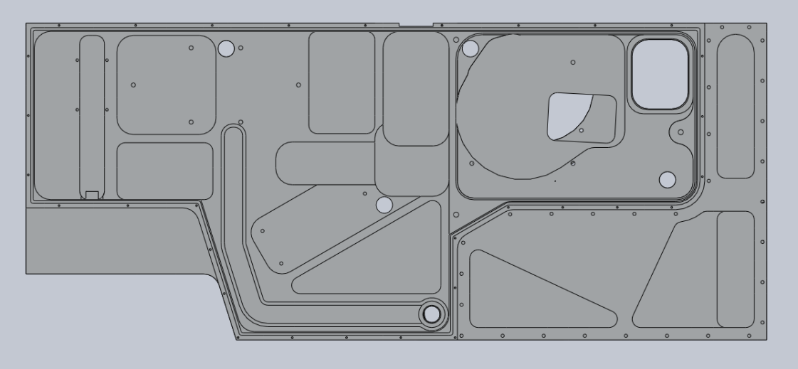
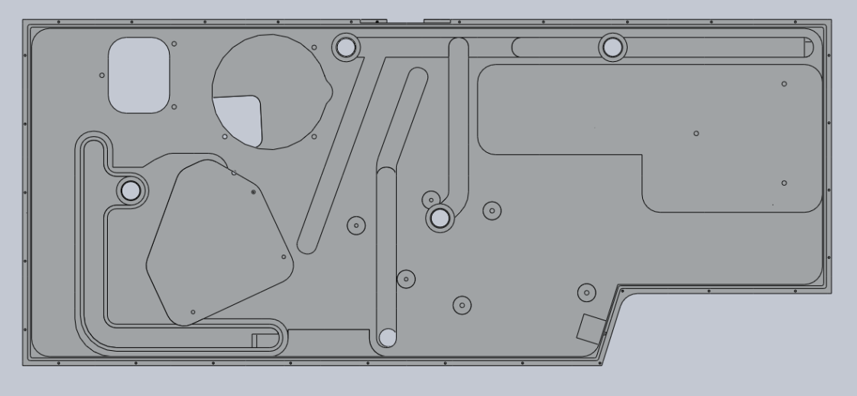
Optics Bench – Wire Routing
Filter Wheel
Rotator
All wires in covered channels
Motor power and heater wires routed together
Hall effect sensors and temperature sensors routed together
Light tight bulkhead connectors
Foreoptics
Slit Wheel
Dekker Mech
OS Mech
IG Mech
Filter Wheel
Motor and Heater Power
Rotator
Position and Temp Sense
Spectrograph
X Disperser Mech

Slide 18
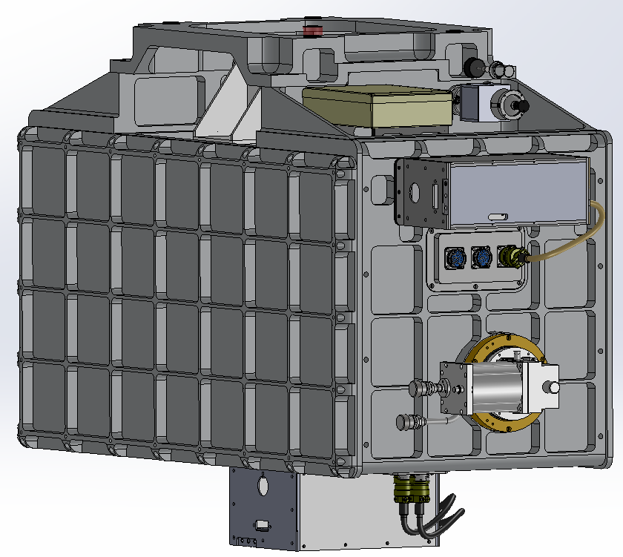
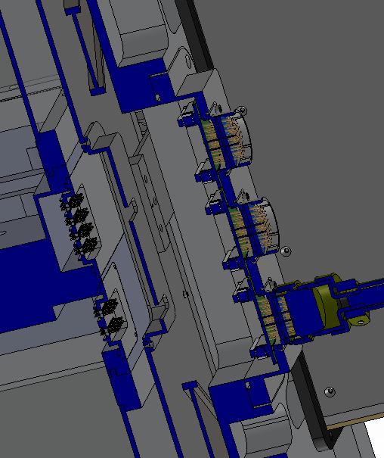
Optics Bench – Connectors
External access to wire harnesses
Hermetic connectors epoxied to a single plate
Radiation shield access panel
Epoxied bulkhead headers on the bench wall
Hall Effect Sense
Temp Sense
Aladdin Sensor

Slide 19
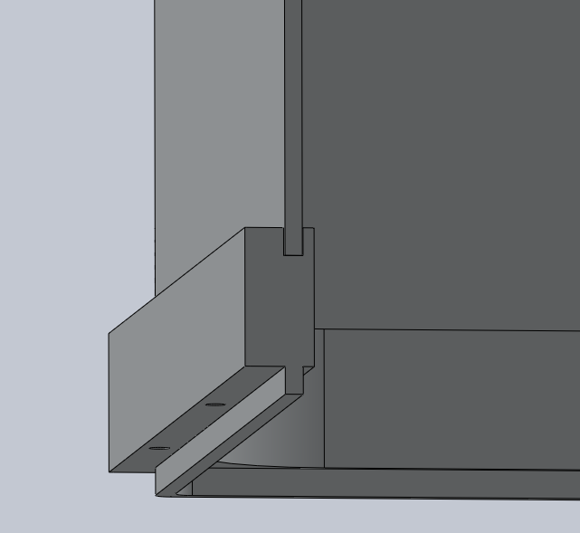
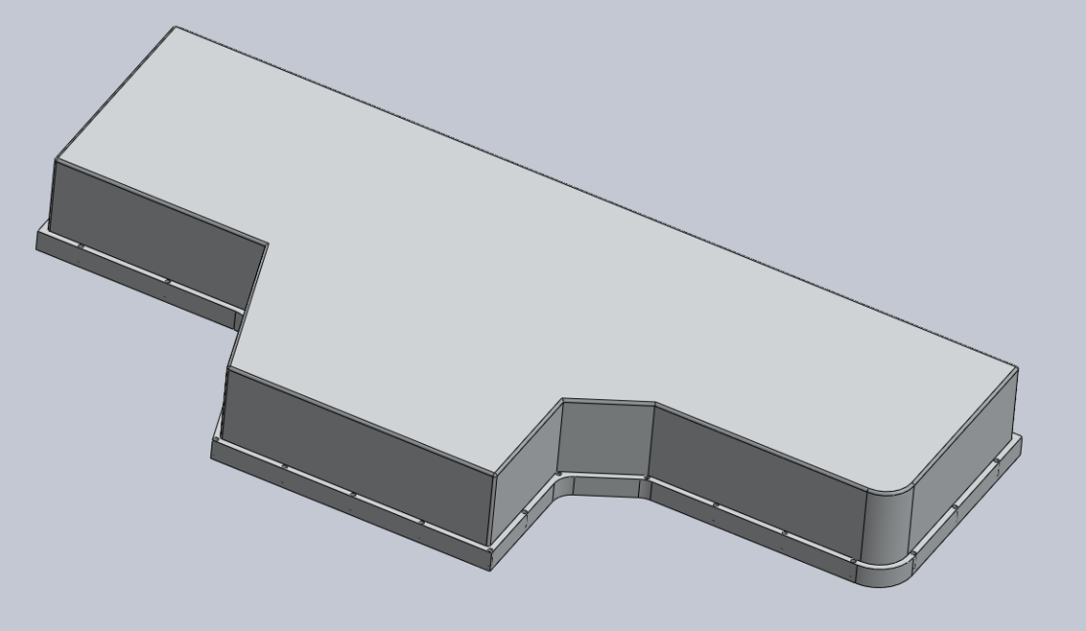
Optics Bench – Photon Shield
Welded Pan (3mm thk)
Machined Flange
Pan welded to flange
Painted inside, polished outside
Qty 31 of #10 captive screws (~4” spacing)
Guide pins used to align tongue and groove during installation

Slide 20
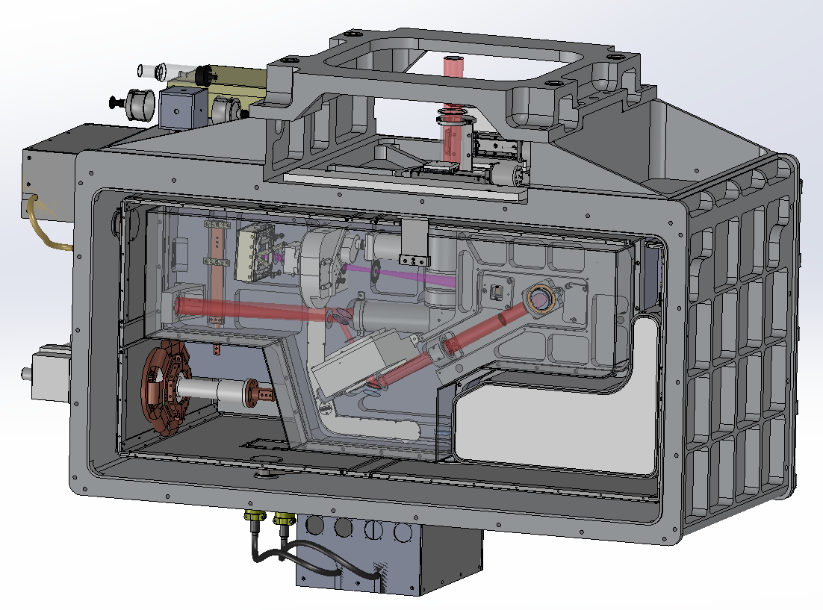
Thermal Design – Hybrid Overview
CCC First Stage Cooled
Radiation Shield
LN Cooled Bench
CCC Second Stage Cooled
Aladdin and H2RG

Slide 21
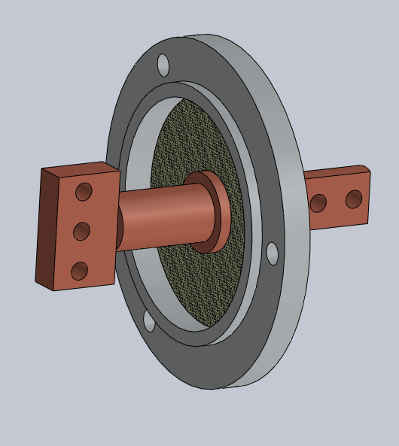
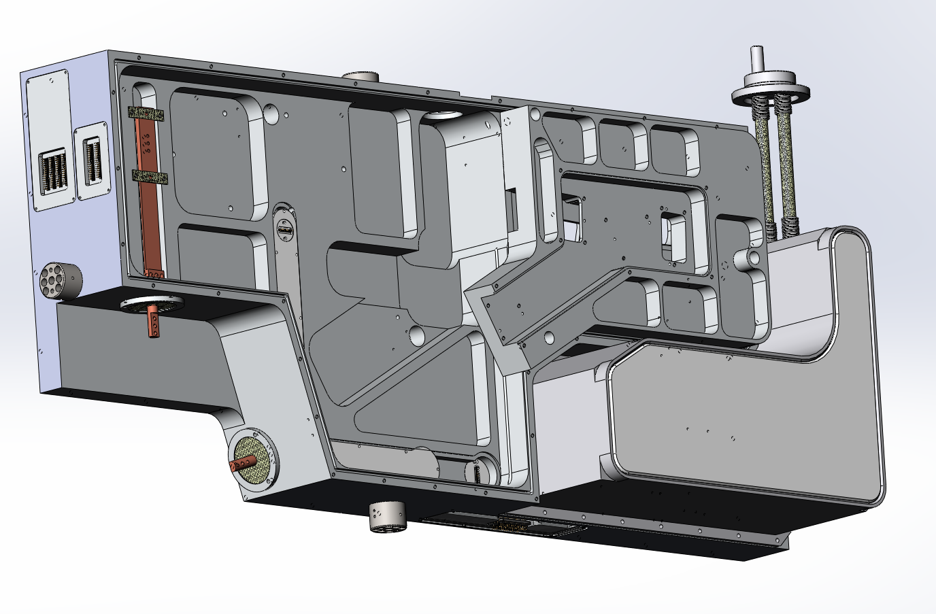
Thermal Design – LN Can
LN Can – milled from billet and welded
LN Neck – Welded bellows, stainless tubes
Cooling Bus Bar mouned with G-10 tabs
Bus Bar Feedthru epoxied to G-10 disk
Bus Bar Feed Thru

Slide 22
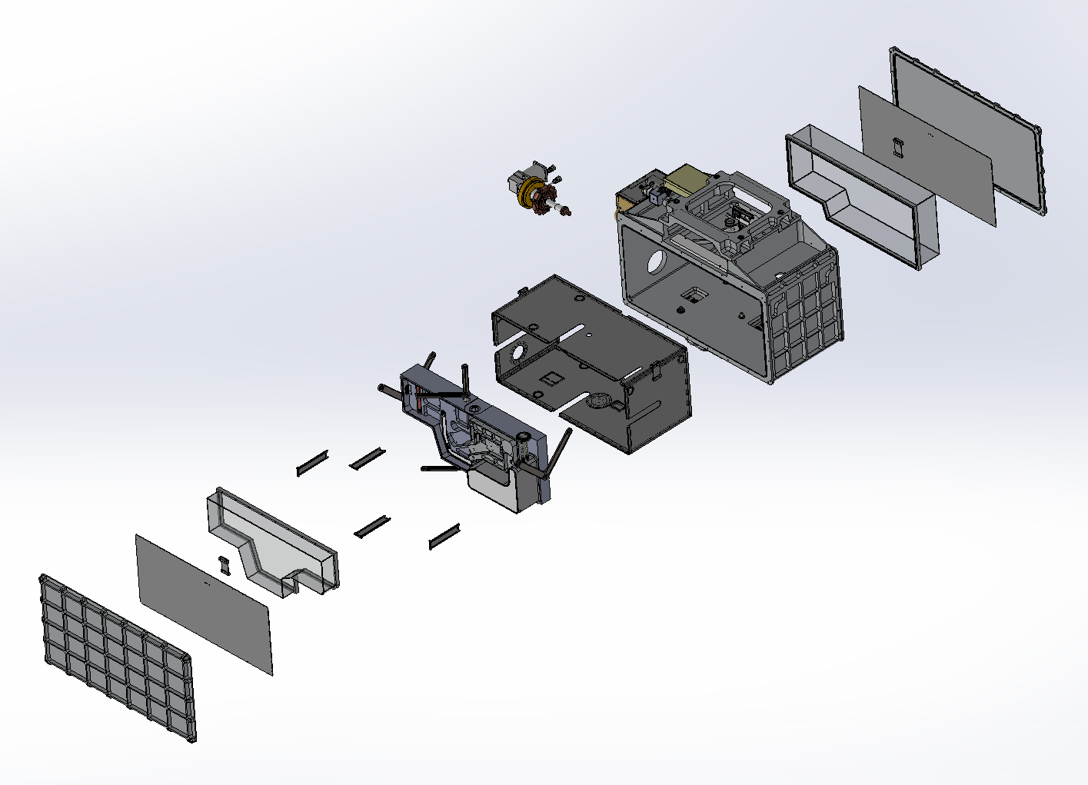
Assembly
Install radiation shield in cryostat
Install bench with trusses
Install truss covers
Install wire harnesses and radiation shield access panels (not shown)
Install cryo cooler and thermal straps
Install mechanisms and optics (not shown)
Install photon shields
10
9
5
1
8
7
2
3
7
8
9
Install remainder of radiation shield mount tabs and radiation shield panels
Install cryostat covers
Install array controllers

