Slide 1
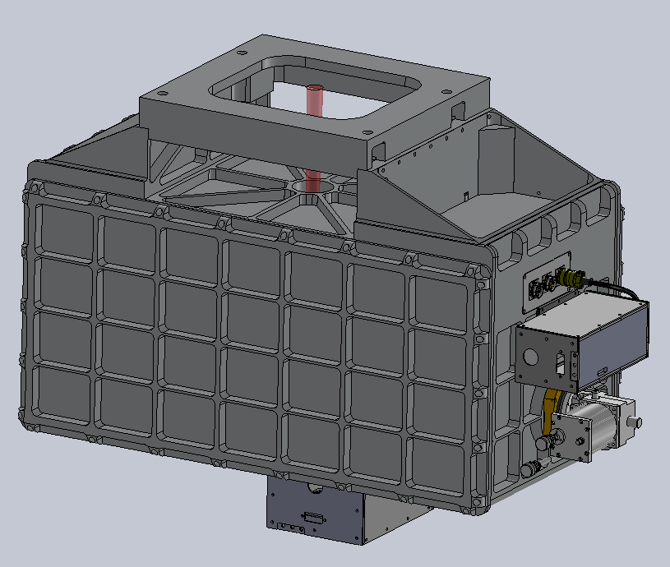
iSHELL Design Review Cryostat & Optics Bench
Dan Kokubun
9/11/2013

Slide 2
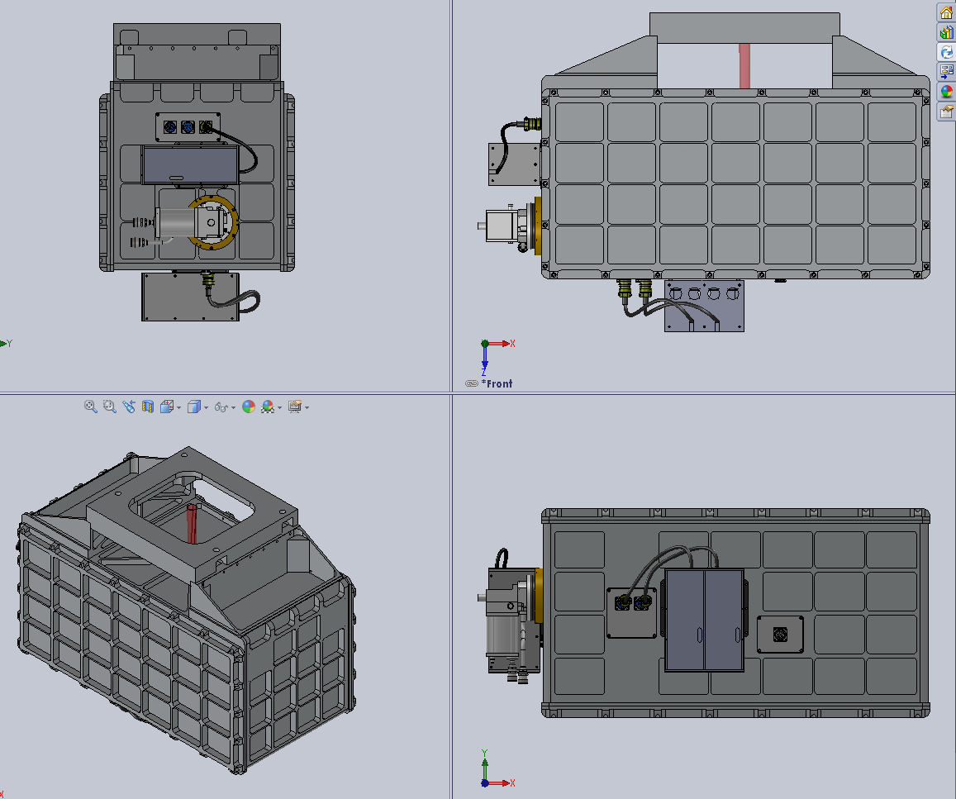
Overview

Slide 3
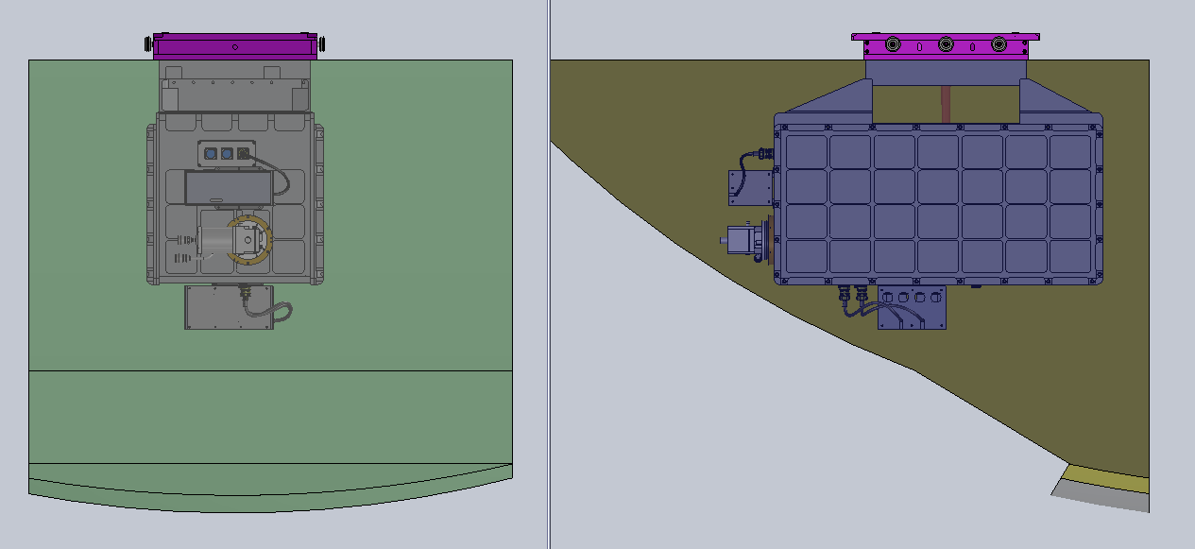
Overview
Estimated Weight: 1040 lbs
CG: within 2” of optical axis
Helium lines run eastward
Hall Effect box placement TBD

Slide 4
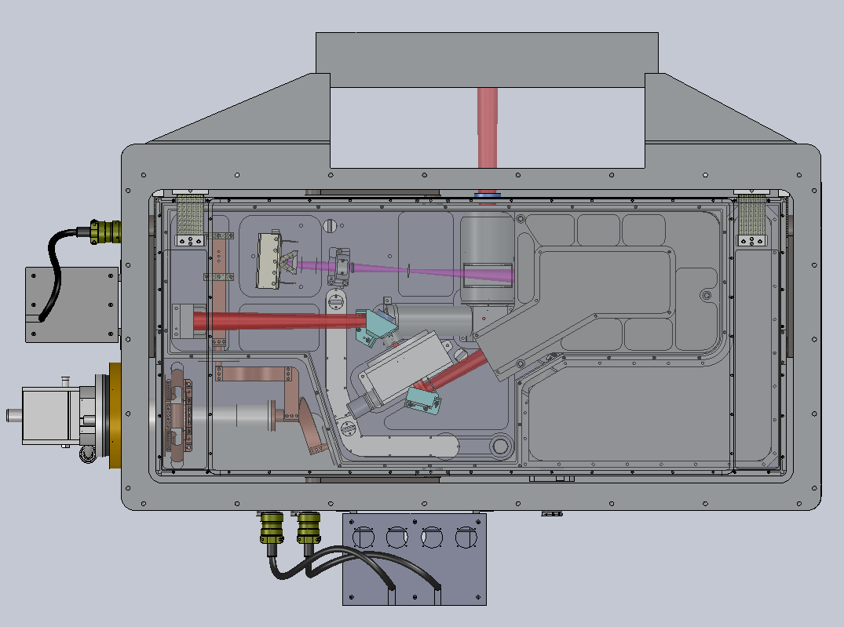
Overview
Aladin
Cal Box
Aladin
Controller
LN Can
Rotator Mechanism

Slide 5
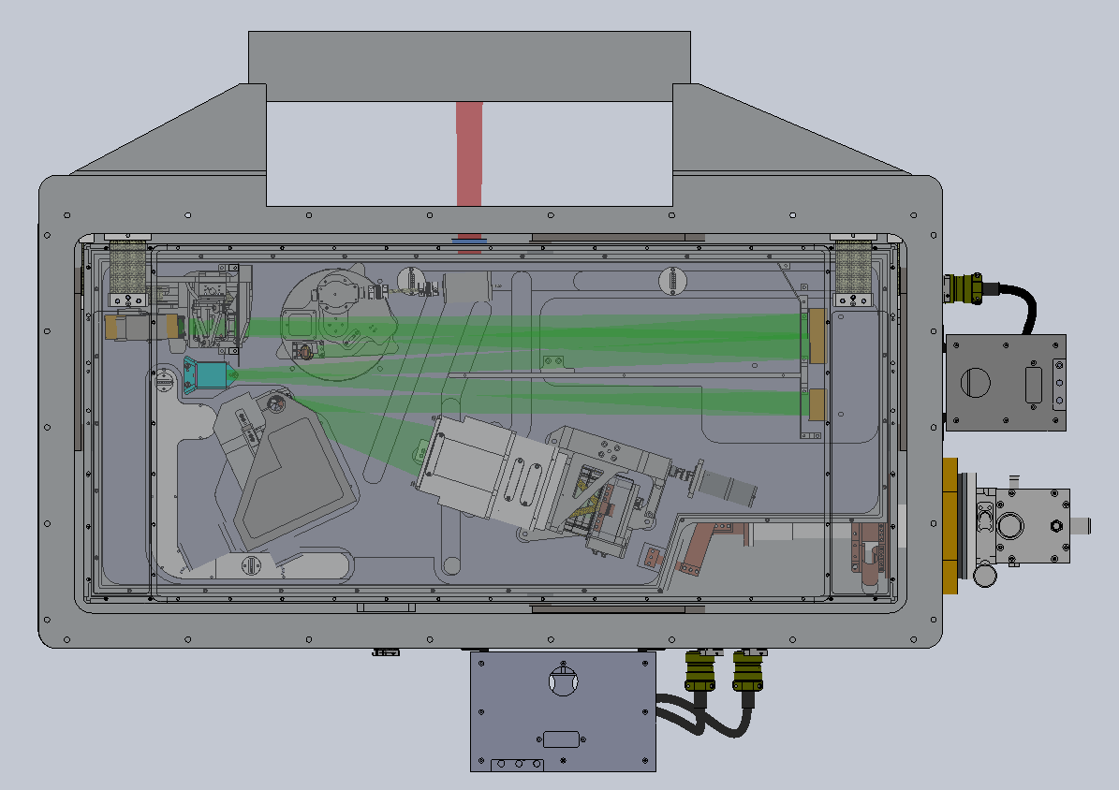
Overview
Order Sorting
Mechanism
IG Changer
*upgrade
Cal Box
X Disperser
Mechanism
H2RG
Controller
H2RG

Slide 6
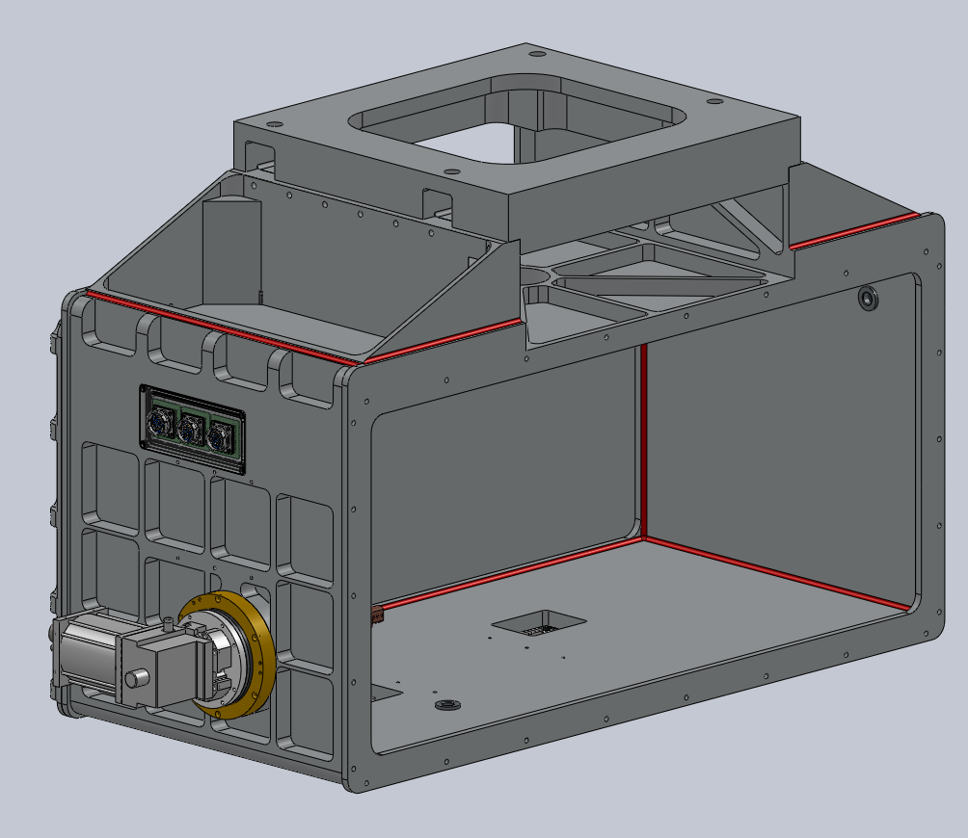
Cryostat - Housing
Welded Structure
Parts milled from billet
Inserts for Truss mounts pressed in place
 | Tensile Yield | Notes
AL 5083-T0 | 21 kpsi | No heat treat
AL 5056-T0 | 22 kpsi | No heat treat
AL 6061-T6 | 40 kpsi | Heat treat required post welding. Severe warping expected

Slide 7
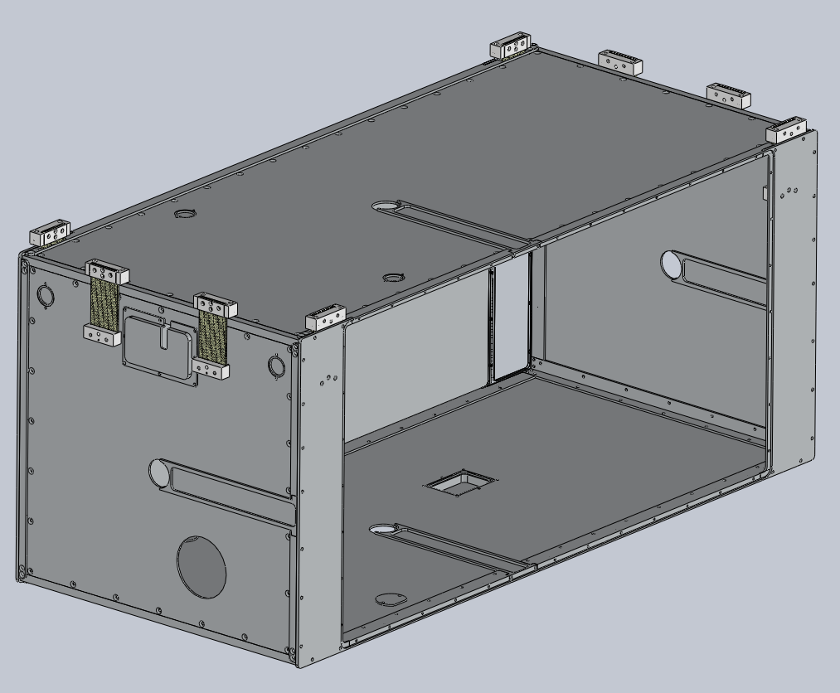
Cryostat – Radiation Shield
Eight G-10 Mount tabs (1.9W heat load)
Pre-polished panels
Access panels for wire harness installation
Slots for truss clearance during installation
Covers for access to truss mount bolts

Slide 8
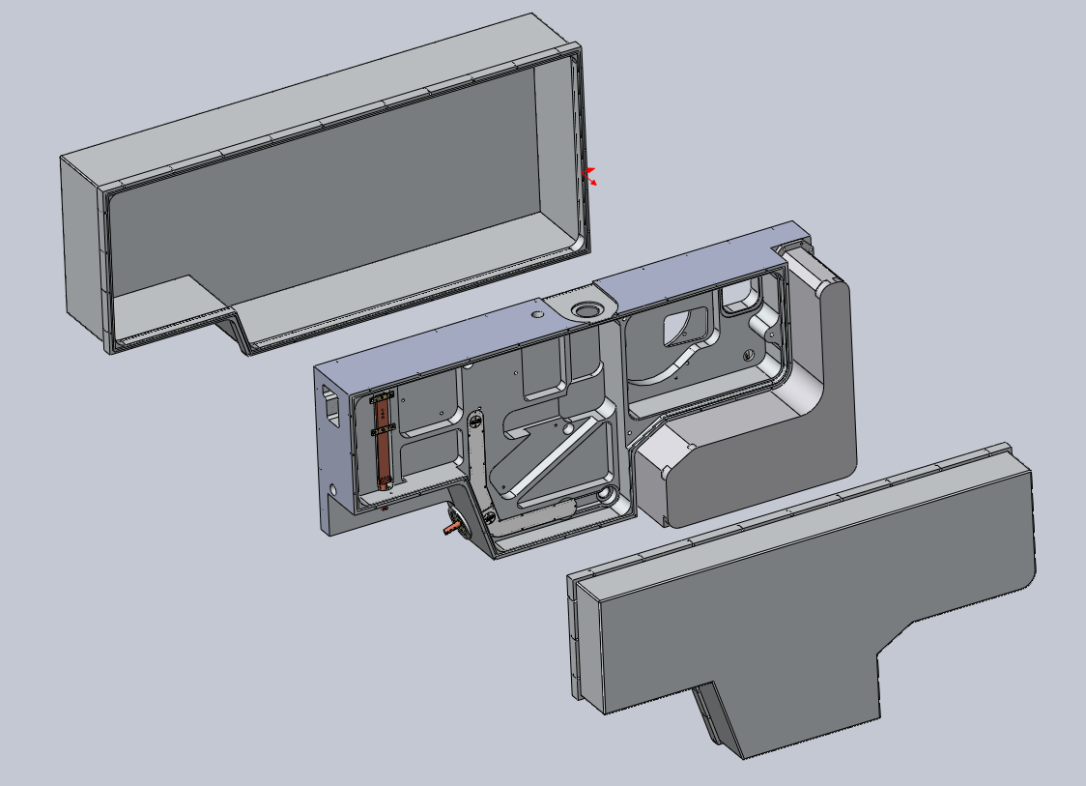
Optics Bench
Photon Shield
Spectrometer
LN Can
Bench
Bus Bar
Photon Shield
Foreoptics

Slide 9
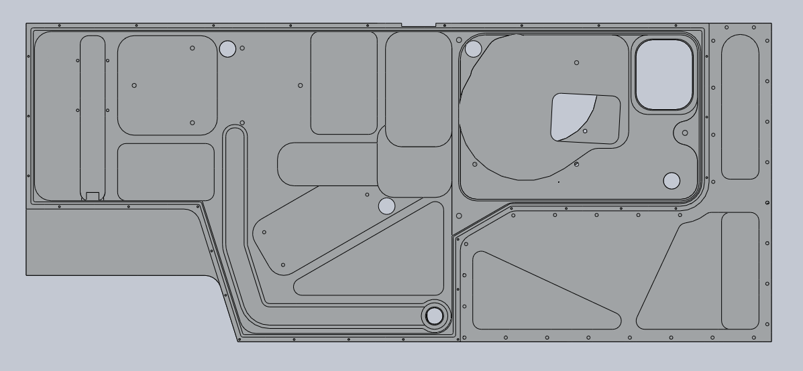
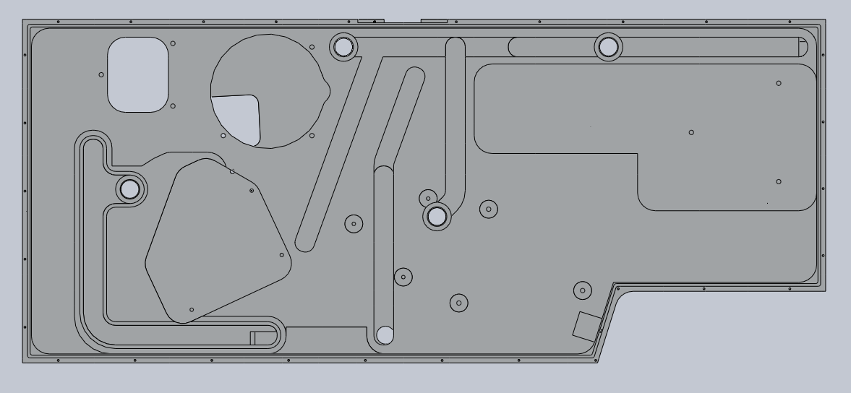
Optics Bench – Wire Routing
Filter Wheel
Rotator
All wires in covered channels
Motor power and heater wires routed together
Hall effect sensors and temperature sensors routed together
Light tight bulkhead connectors
Foreoptics
Slit Wheel
Dekker Mech
OS Mech
IG Mech
Filter Wheel
Rotator
Spectrograph
X Disperser Mech

Slide 10
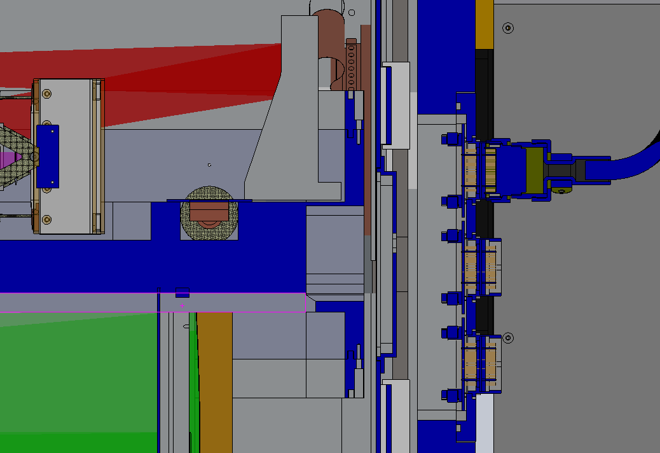
Optics Bench – Connectors
External access to wire harnesses
Hermetic connectors epoxied to a single plate
Radiation shield access panel
Aladin
Temp Sens
Hall Effect Sens

Slide 11
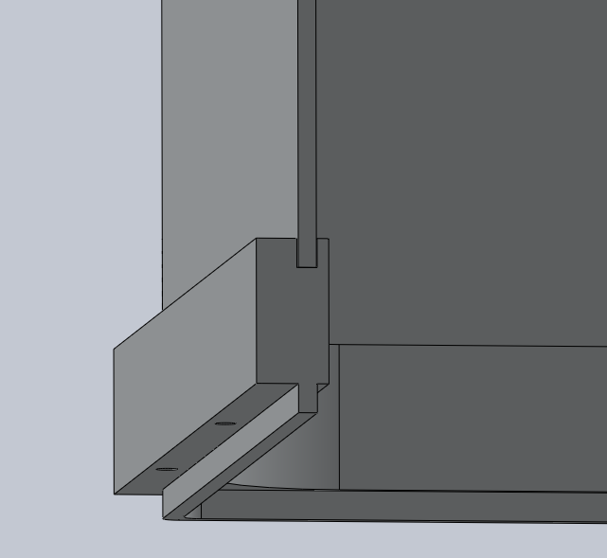
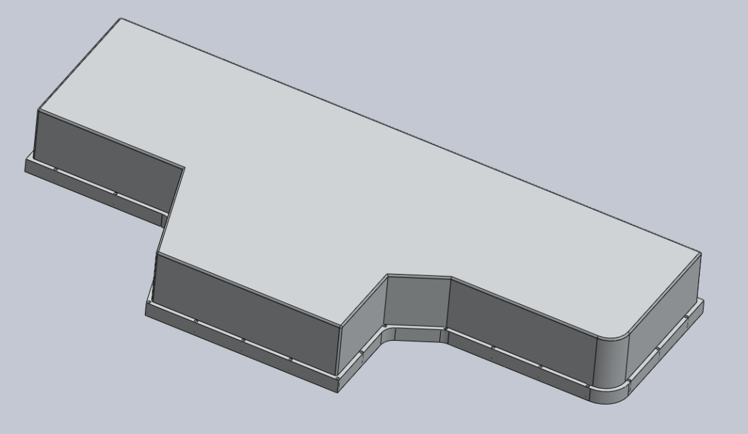
Optics Bench – Photon Shield
Welded Pan (3mm thk)
Machined Flange
Epoxied joint
Painted inside, polished outside
Qty 32 of #6 screws (4” spacing)

Slide 12
Thermal Design – Hybrid Overview
CCC First Stage Cooled
Radiation Shielde
LN Cooled Bench
CCC Second Stage Cooled
Aladin and H2RG

Slide 13
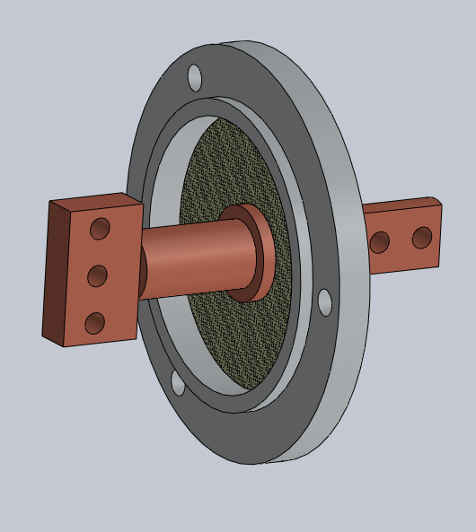
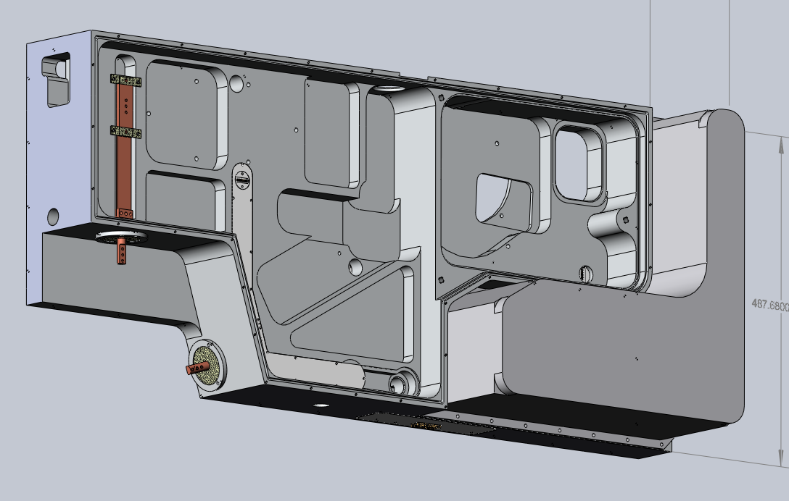
Thermal Design – LN Can
LN Can – milled from billet and welded
Cooling Bus Bar mouned with G-10 tabs
Bus Bar Feedthru epoxied to G-10 disk

Slide 14
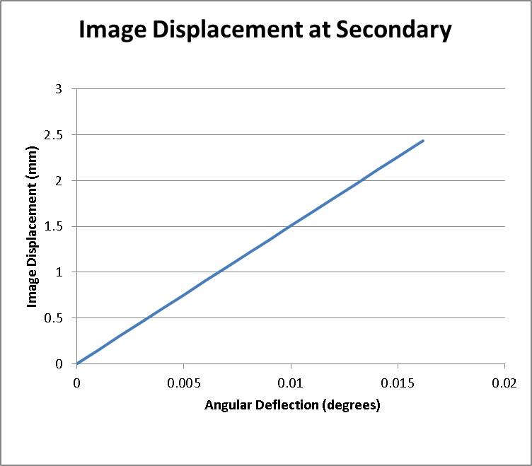
Cold Stop Alignment Requirement
Requirement:
To achieve an absolute flux calibration of 1%, the cold stop and telescope exit pupil need to remain co-aligned to within 1% of their diameters both while observing the object, and while performing the flux standard star observations. – Instrument Top Level Specification
Flow Down:
+/- 2.4 mm image movement at the secondary
1% of Secondary Diameter
Secondary Diameter is 243.84mm
Secondary vertex to Instrument mounting face distance is 8632.84mm
+/-0.016 deg max angular deflection (total budget)

Slide 15
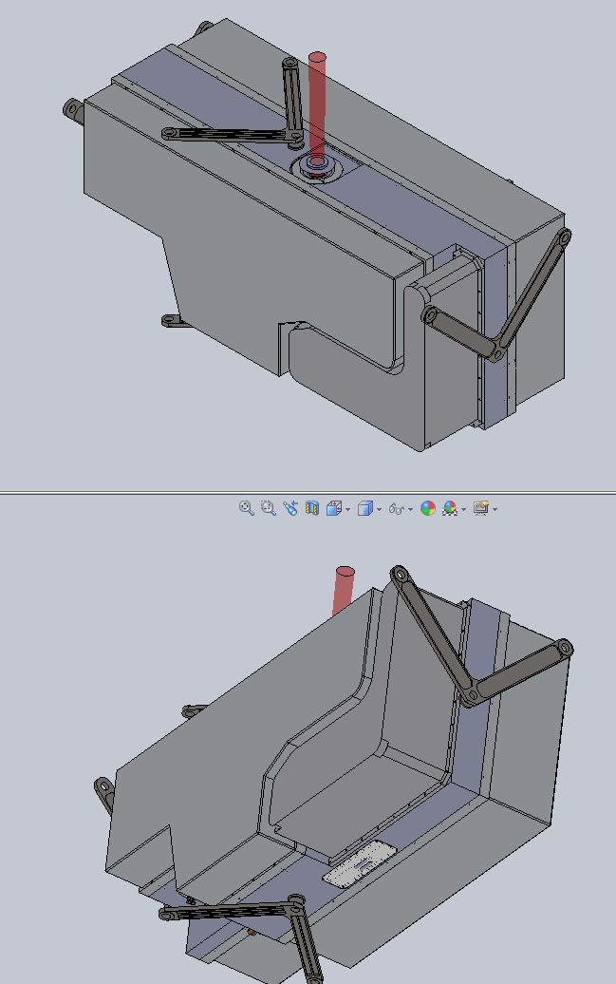
FEA – Displacements
Approximate Results
Three Truss: .015 deg
Four Truss: .005 deg
4W thermal load

Slide 16
Assembly
Install radiation shield in cryostat
Install bench with trusses
Install RS truss covers
Install wire harnesses and RS access panels
Install photon shields
Install remainder of radiation shield mount tabs (2 per side)
Install radiation shield panels
Install cryostat covers

Slide 17
Notes from Reviewers
WS: Use 1/32 tabs with G10 washers for the bus bar mounts
WS: Use Bellville washers under the cold strap screws
WS: Use t&g on the bus bar feed thru flanges
Weight Issue:
SpeX is 1100 lbs
Cshell is 300 lbs
Consider weight reduction possibilities for iSHELL\
WS: Reuse SpeX handling equipment if possible
RC: Find out if the cryostat vendor will do post weld stress relief
WS: Make sure the truss mounts are correctly positioned post welding
DW: The radiation shield has over constrained tabs.
??: Add captive screws on the photon shields
JR: Add a key on the wiring slide (what is blue and what is red)
WS: Epoxy needs to be painted where light leaks are an issue
EW: Use separate holes in the radiation shield for the Aladdin and the other wiring
Multiple: provide more space for wire harness service loops under the connector plates. Suggest making a top hat out of the connector plate.
RC: Use #6-40 screws on the photon shield if larger screws cannot be used.
Don’t forget to include temperature sensors for engineering evaluation
Need to resolve epoxy vs. welding approach for the photon shields
JR: Need a getter on the cold finger
JR: Need to fine tune the A/L for the bus bars and flexible straps
AT: Review the FEA with Vern and Morgan
AT: Need to develop an assembly plan and handling equipment
Need to make the cryostat bigger. Allow for ½” clearance between the radiation shield and the cryostat/bench. DK: Will also consider making the photon shield flanges wider to accommodate larger screws.
AT: have followup detailed design reviews in two parts
1. Discussion of assembly and optical alignment
2. Final review at the 100% completion mark
JR: Add the Slit viewer assembly in the applicable slides

