Slide 1



iSHELL Mechanisms: Slit Viewer Assembly
Status Report: 09/06/2013
Author: Morgan Bonnet / Updated: 09/06/2013

Slide 2
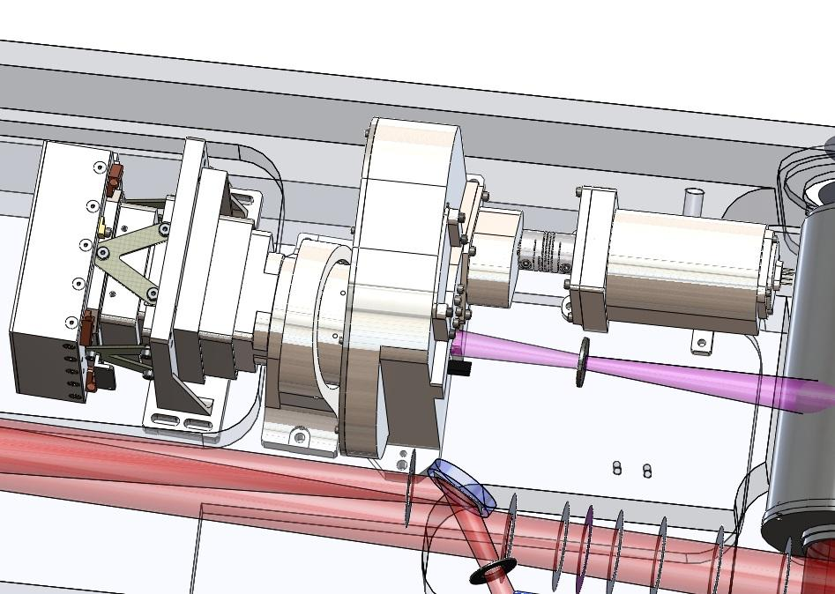
Overview
Slit Viewer Detector Mount
Camera Doublet
Slit Viewer Filter Wheel

Slide 3
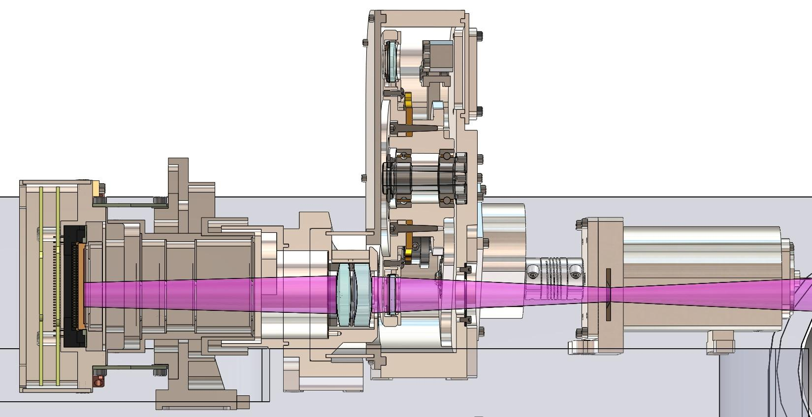
Overview: Cross-Section
Aladdin Detector
Camera Doublet
Filter / Pupil
Viewer
Cold Stop

Slide 4
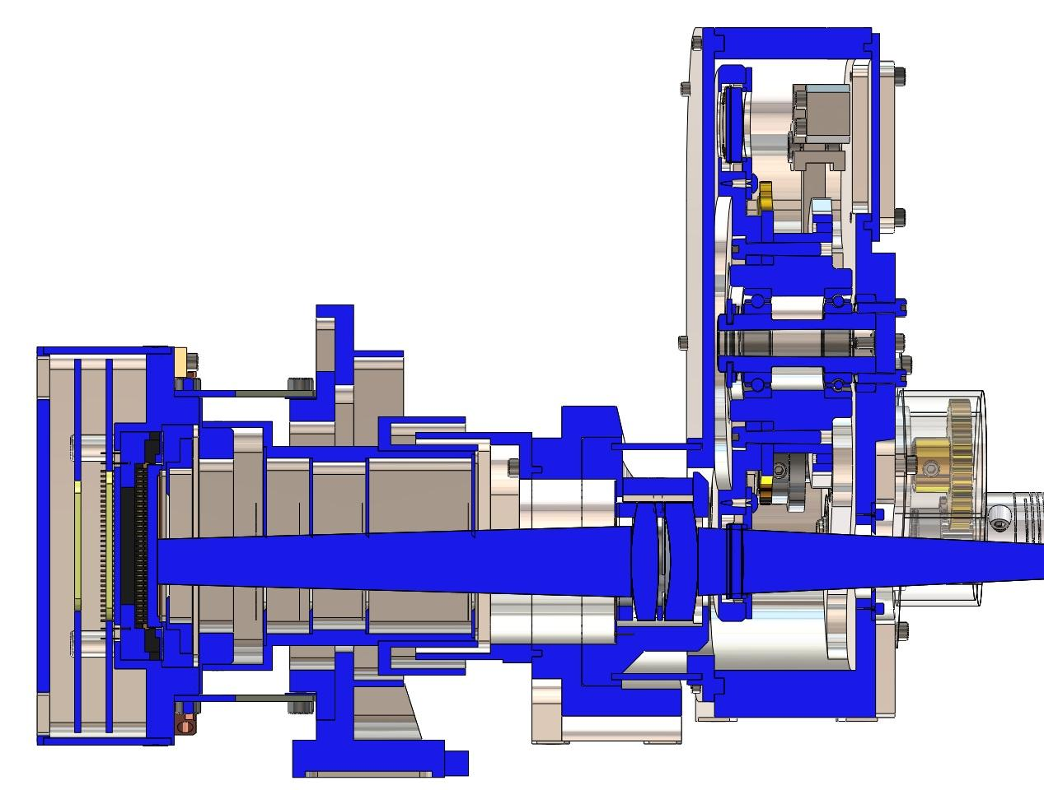
Overview: Cross-Section

Slide 5
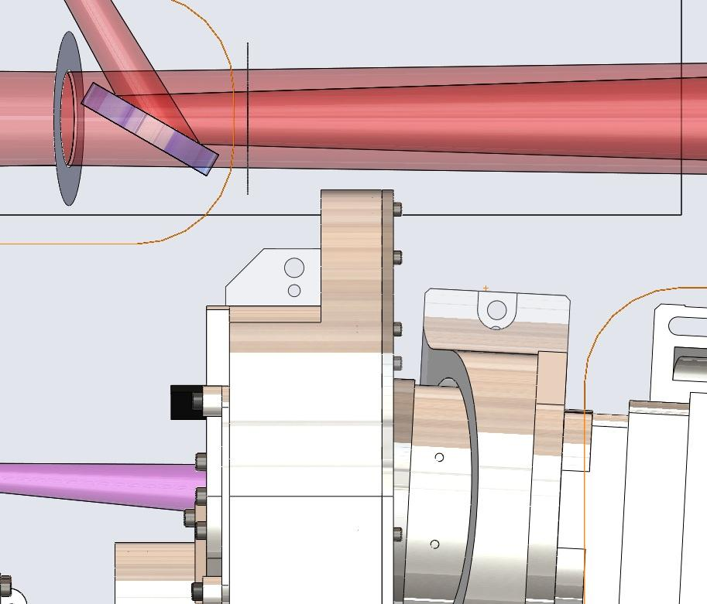
Beam Clearance: Side View

Slide 6
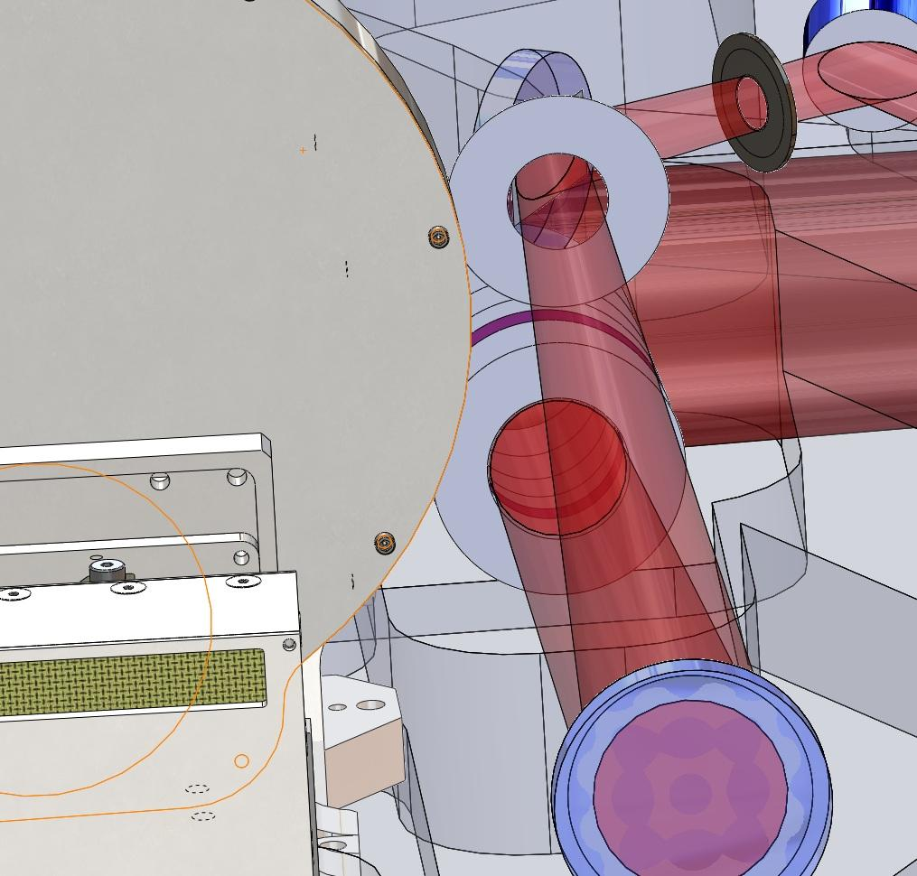
Beam Clearance

Slide 7
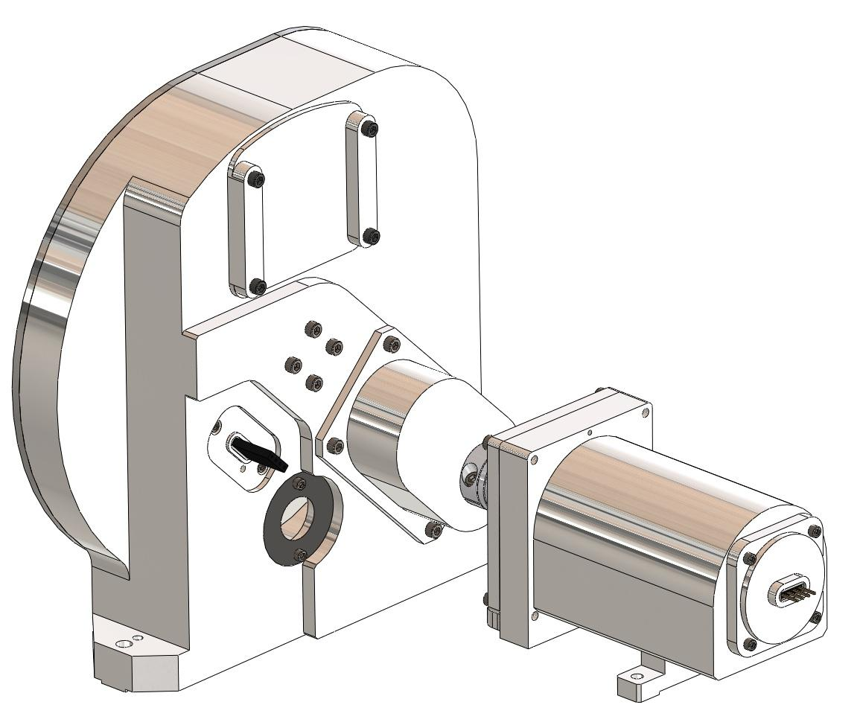
Filter Wheel
Access Cover
Hall Effect Sensor Mount
Entrance Baffle
Stepper Light-tight Mount

Slide 8
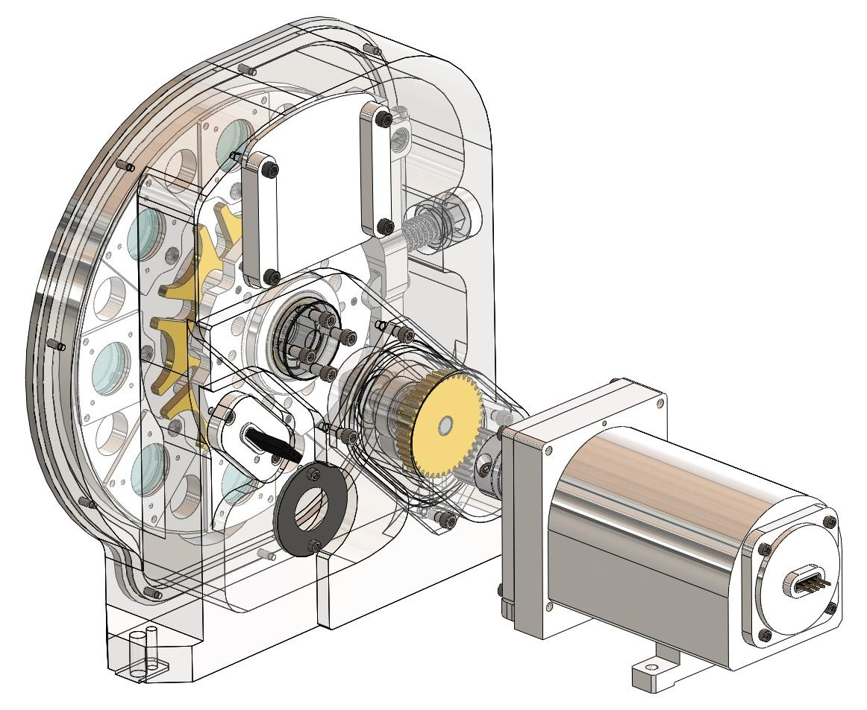
Filter Wheel

Slide 9
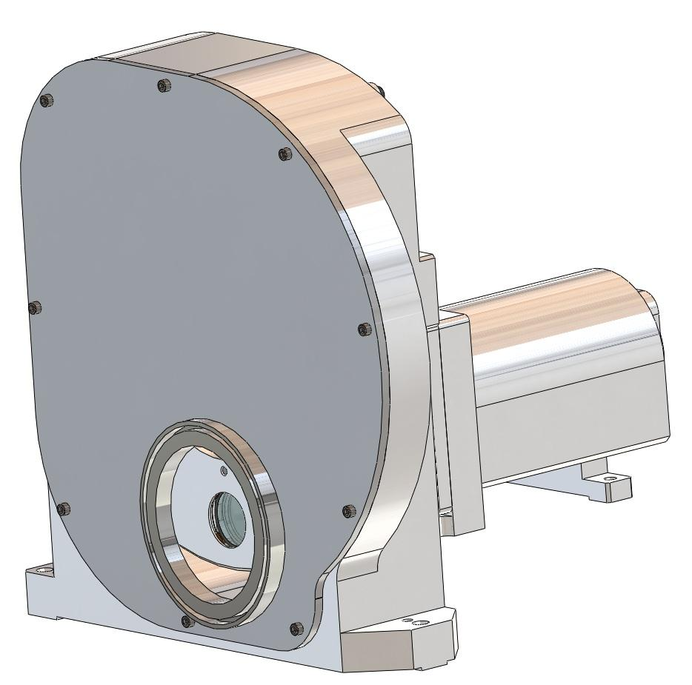
Filter Wheel
Light-tight Tube Interface

Slide 10
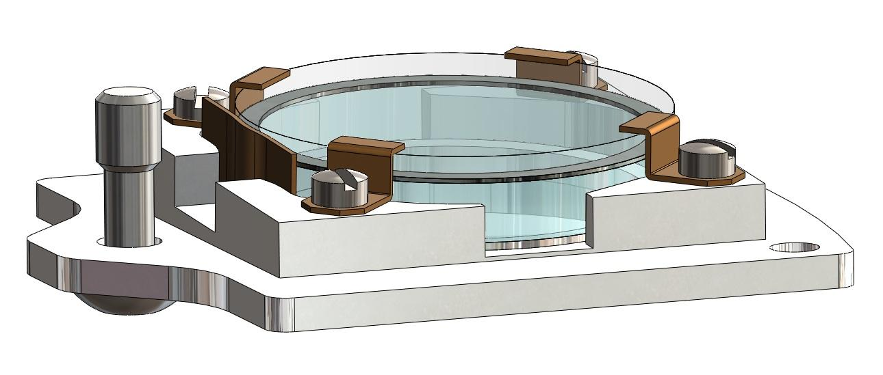
Filter Wheel: Pupil Viewer
Filter
Indium Gasket
Pupil-Viewer Lens

Slide 11
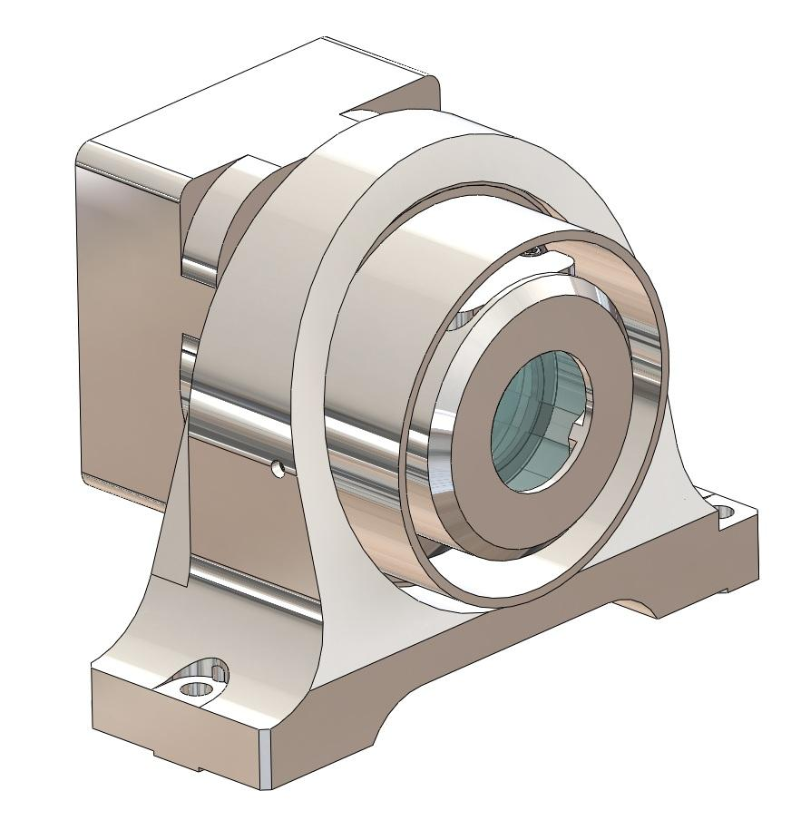
Camera Doublet Mount

Slide 12
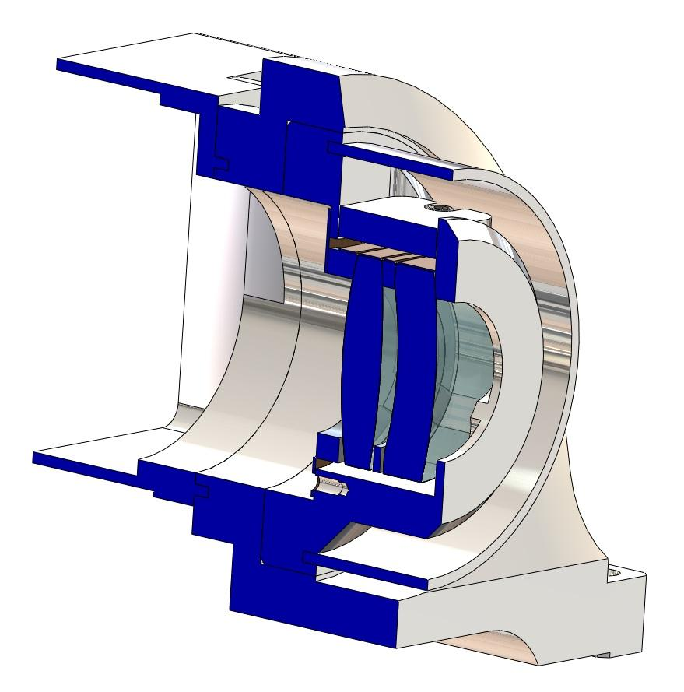
Camera Doublet Mount: X-Section
Light-tight Tube -> To Filter Wheel
Light-tight Tube -> To Detector Mount

